Slide 1

ABB Ltd
Company Profile
Notes:
https://craft.co/
https://www.mbaskool.com/brandguide/energy/5665-abb-ltd.html

Slide 2

Overview
Overview: ABB is a company providing electrification, automation, robotics, and digitalization solutions to industrial customers.
Type: Public
Founded: 1988
Headquarter: Switzerland
No. of employees: 105,600 (Dec 2020)
Area served : Worldwide
Business Areas : Electrification, Process Automation, Motion, Robotics & Discrete Automation
Products & Services : Control Room Solutions, Drives, Electric Vehicle, Charging, Infrastructure, Low Voltage Products and Systems Measurement and Analytics, Medium Voltage Products, Metallurgy Products, Motors and Generators, PLC Automation, Power Converters and Inverters, Robotics
Merger & Acquisition: Acquired , Codian Robotics, a leading provider of delta robots, which are used primarily for high-precision, pick-and-place applications for industries like food and beverage and pharmaceuticals.
27.98 B
Industries Served: Aluminium, Automotive, Buildings & Infrastructure, Cement, Channel Partners, Chemical, Data Centers, Food and Beverage, Process Automation, Life Sciences, Marine, Metals, Mining, Oil and Gas, Ports, Power Generation, Printing, Pulp and Paper, Railway, Smart Cities, Solar Power, Water, Wind Power
FY,2020
FY,2019

Slide 3
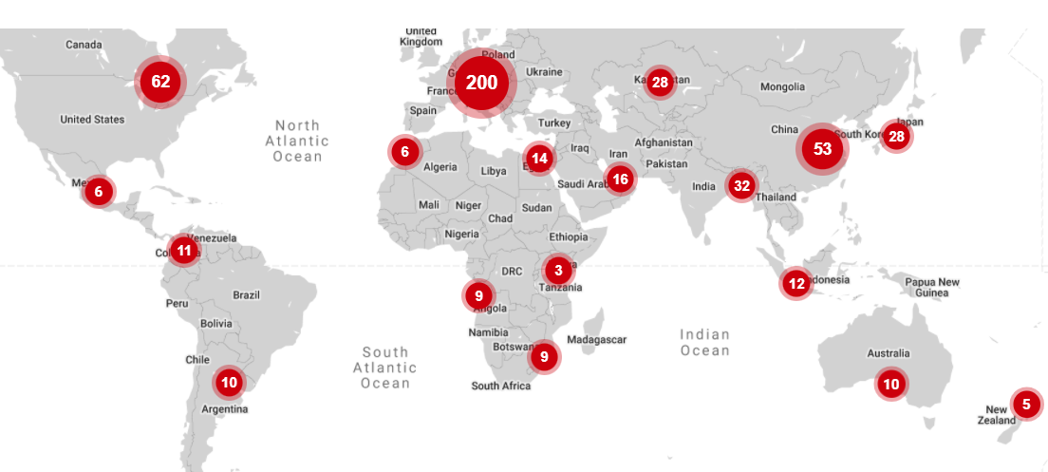
Locations
ABB has 560 offices in 89 countries around the world

Slide 4
Revenue
 | FY, 2018 | FY, 2019 | FY, 2020
Revenue | $27.66 b | $27.98 b | $26.13 b
Net Income | $2.3 b | $1.5 b | $5.2 b
Growth | (19.00%) | 1.14% | (6.59%)

Slide 5
Revenue Breakdown
FY, 2020
FY, 2020

Slide 6
Recent News
Product & Service | Feb 24, 2021 | ABB launches next generation cobots to unlock automation for new sectors and first-time users
Recent Orders | Aug 19, 2021 | ABB secures $120 million order to power Jansz-Io Compression project
Merger & Acquisions | Jul 20, 2021 | ABB to acquire ASTI Mobile Robotics Group to drive next generation of flexible automation with Autonomous Mobile Robots
 | Oct 02, 2020 | ABB enhances portfolio of high-speed industrial robots with Codian acquisition
Partnership | Nov 18, 2021 | ABB partners with start-up Sevensense to drive next generation autonomous mobile robots
 | Mar 22, 2021 | ABB and ETH extend partnership to advance research into the future of robotics

Slide 7
















Customers

Slide 8
SWOT Analysis
STRENGTHS
WEAKNESSES
Huge installed customer base with long term contracts
Superior brand value has helped it in cross selling and gave a lot of aftermarket sale opportunities.
ABB has resources all over the world and is geographically well spread
The management has a history of overpaying for acquisitions and not delivering synergies on previous deals
On the back of shortage of liquidity, the margin is not improving in the shorter term
Bad debts and Financial difficulties with customers have increased the debtor's provisions affecting profit
OPPORTUNITIES
THREATS
Government initiatives in the infrastructure space will augment overall demand for power industry.
It is financially strong with huge cash flows which will help in acquisitions, buybacks and dividends
Increase in demand for smart grids increase demand for any companies that manufacture, supply or build smart grid infrastructure
A bad outlook of the economy will affect the cash flows and growth of the economy
Governments are under pressure for cutting down the costs, which may slow down replacement sales and put overall sales at risk

